Slide 1
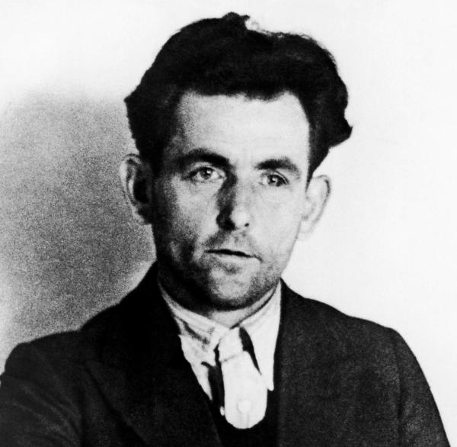
"I'm just looking at how to improve working conditions and avoid the war. The observations I made led me to the conclusion that the conditions in Germany could only be changed by the elimination of the current leadership. "
pic.1
“Ich stellte allein Betrachtungen an, wie man die Verhältnisse der Arbeiterschaft bessern und einen Krieg vermeiden könnte. Die von mir angestellten Betrachtungen zeitigten das Ergebnis, dass die Verhältnisse in Deutschland nur durch eine Beseitigung der augenblicklichen Führung geändert werden könnten.”

Slide 2


Georg Elser
- He could have changed the world -

Slide 3
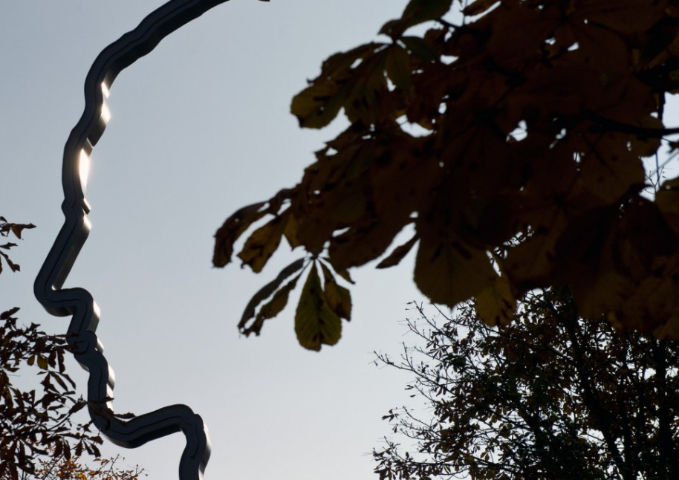
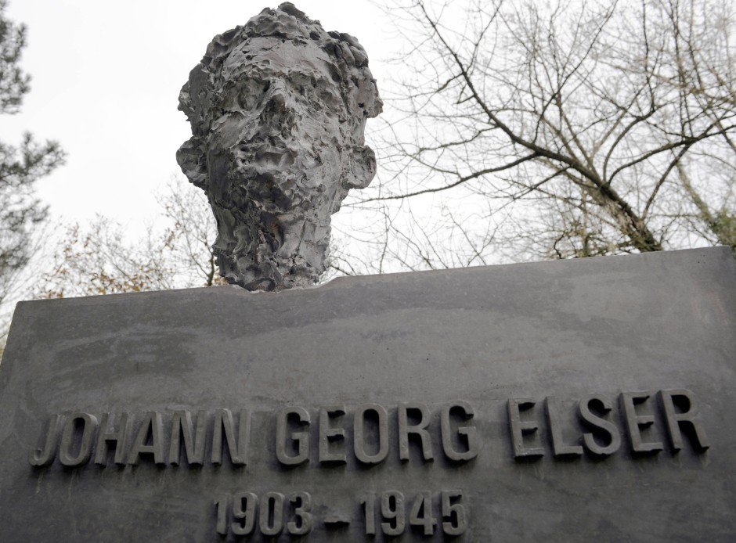
Contents
Personal information
The planning of the assassination: 1938
The preparation of the assasssination
The 8th of November, 1939 - the attempt
The evening of the attempt - a short video
The arrest
The interrogation
The last days of Georg Elser
The reactions of the public
Sources pictures/ video
pic.2
pic.3

Slide 4
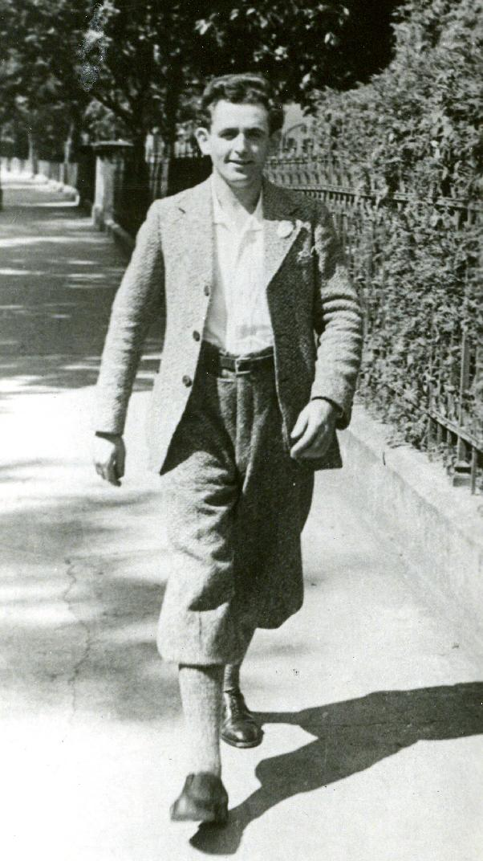
Personal information
Name: Johann Georg Elser
Born: 4th of January, 1903 (Hermaringen)
Died: 9th of April, 1942 (Dachau, concentration camp)
Cause of death: executed
Parents: illegitimate child of Maria Müller and Ludwig Elser
Education: - primary education (1910-1917)
- He began a training as an iron turner , but he had to end it, because of health reasons, after that he began a training as a carpenter, which he completed 1922.
pic.4

Slide 5
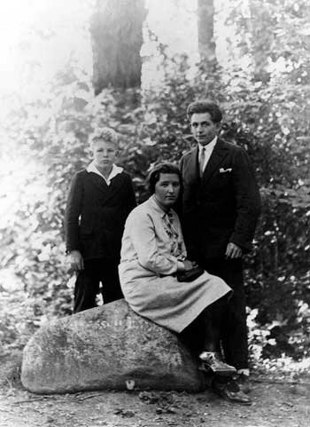
Personal information
Family:
  had an illegitimate child with M. Niedermann, Manfred Elser, born 1930
  had to return to Königsbronn, in 1932, because his father turned out as an alcoholic, his dad had many liabilities, → he helped his mother
Georg Elser, Mathilde Niedermann, Manfred Elser
pic.5

Slide 6
The planning of the assassination: 1938
From the beginning, he did not like the actions of the National Socialists → he was always very critical
Autumn 1938: Elser decided to remove the leadership of the NS
8.11.1938: He came to Munich for the first time (to the „Bürgerbräukeller“), where the „Hitlerputsch“ took place.
→ He decided to plan the assassination in the „Bürgerbräukeller“ .
→He started planning an explosive attack.

Slide 7
The preparation of the assassination
In Heidenheim, he procured 250 pieces of pressed powder.
He developed plans for explosive devices and the ignition mechanism.
He even prepared his escape plan via Switzerland.
He worked in Königsbronn, in a quarry, to obtain explosives, but after an accident at work in May 1939, he concentrated only on the attack.
In April 1939, he looked after the guarding of the cellar and he measured the column, where the explosives came in.
From August 1939 he lived from savings in the Türkenstraße in Munich.
Night after night, he locked himself secretly in the „Bürgerbräukeller“ for preparing the attack.
In November 1939, everything was ready for the assassination.

Slide 8
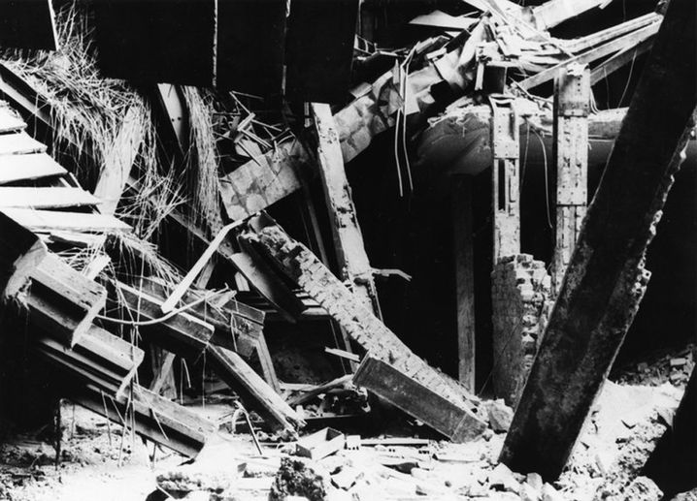
The 8th of November, 1939 - the attempt
At first, Hitler did not want to hold his speech in Munich that day, because of a planned war attack on Germany.
→but eventually he came to Munich
He spoke shorter than it was planned.
At 09.07 p.m., Hitler left, because he had to go back to Berlin.
At 09.20 p.m., the detonator exploded.
Result: 8 people killed, 60 people injured
The entire „Bürgerbräukeller“ was demolished.
pic.6

Slide 9
The arrest
On the 8th of November about 08.45 p.m. (before the explosion), Georg Elser was arrested.
He got arrested, because he tried to get illegally into Switzerland.
They became aware of his suspicious bag with a map of the “Bürgerbräukeller”, a badge of the “Roter Frontkämpferbund”, etc..
The Gestapo brought him to Munich, where he was interrogated and tortured.
They confiscated the entire possession of Georg Elser`s sister, which included the tools he used to prepare the column for the explosion.
Almost his whole family was arrested, too .
The Gestapo wanted to know if they had something to do with the attack, but when they could not find anything, they obliged them to be strictly silent and let most of them out of custody.

Slide 10
The interrogation
The head of the commission Franz Josef Huber interrogated Georg Elser on the 12th of November, 1939.
The Gestapo knew that the assassin worked on knees and Georg Elser had an infected knee.
Huber confronted Elser, after that he confessed everything in detail in the night from the 13th of November to the 14th of November, 1939.
The officers were nearly convinced that he had worked alone.
On the 19th and 23th of November he had to confess again in Berlin.
The Nazi leadership did not trust the investigation results, so they interrogated Georg Elser again for 15 hours.

Slide 11
The last days of Georg Elser
In the concentration camp in Sachsenhausen, he was fully isolated and made small furniture for the guards.
In the beginning of 1945, the Gestapo brought Georg Elser in the concentration camp Dachau.
Here he was again in solitary confinement and made furniture.
When the Nazi leadership realised that they have lost the war, they shot Georg Elser on the 9th of April, 1945 .
He was shot, because he was an enemy of the Nazis and they did not want that their enemies live and shape the future.

Slide 12
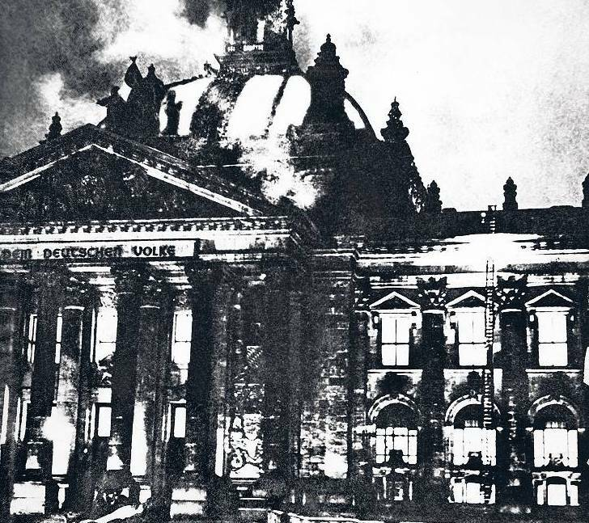
The reactions of the public
The people were wondering, who carried out the attack.
Many people believed, it was the Nazis themselves
because of the „Reichtag“ fire on 28 of Febuary, 1933
Even after the arrest of Georg Elser, most people did not believe that it was Elser alone.
pic.7

Slide 13
The End
„I wanted to prevent the war“
(Georg Elser)
presentation by Mathilda Bürgstein, Olivia Popovichiu and Maria Waldenmaier

Slide 14
If you want to watch a short video about Georg Elser, here is a link:
https://www.youtube.com/watch?v=4WXepTm2Rpw&t=2s (09.11.2020)

Slide 15
Sources pictures/ video
Pic.1: https://www.welt.de/geschichte/zweiter-weltkrieg/article202947518/Georg-Elser-Seine-Bombe-gegen-Hitler-explodierte-puenktlich-13-Minuten-zu-spaet.html (09.11.2020)
Pic.2: https://www.sueddeutsche.de/kultur/hitler-attentaeter-georg-elser-denkmal-fuer-einen-tragischen-helden-1.1183383(09.11.2020)
Pic.3: https://www.faz.net/aktuell/gesellschaft/menschen/warum-koenigsbronn-georg-elser-so-spaet-ehrte-13254104.html(09.11.2020)
Pic.4: https://www.was-konnten-sie-tun.de/themen/th/die-ns-fuehrung-ausschalten/ (09.11.2020)
Pic.5: https://www.heiligenlexikon.de/BiographienG/Georg_Elser.html(09.11.2020)
Pic.6: https://www.spiegel.de/consent-a-?targetUrl=https%3A%2F%2Fwww.spiegel.de%2Fgeschichte%2Fgeorg-elser-und-das-attentat-auf-adolf-hitler-nur-13-minuten-fehlten-a-1142134.html&ref=https%3A%2F%2Fwww.google.com%2F(09.11.2020)
Pic.7: https://www.tagesspiegel.de/wissen/ns-zeit-das-raetsel-reichstagsbrand/7831632.html(09.11.2020)

Slide 16
Sources
The quote on the first slide is taken from: https://gutezitate.com/zitat/122150 ( 16.11.2020), aus dem Protokoll der Vernehmung Elsers durch die Gestapo am 21. November 1939.
The information on Georg Elser presented in this presentation is taken from: https://www.georg-elser.de/ (16.11.2020). The website is in German, so the information got translated to our best knowledge.

