Slide 1
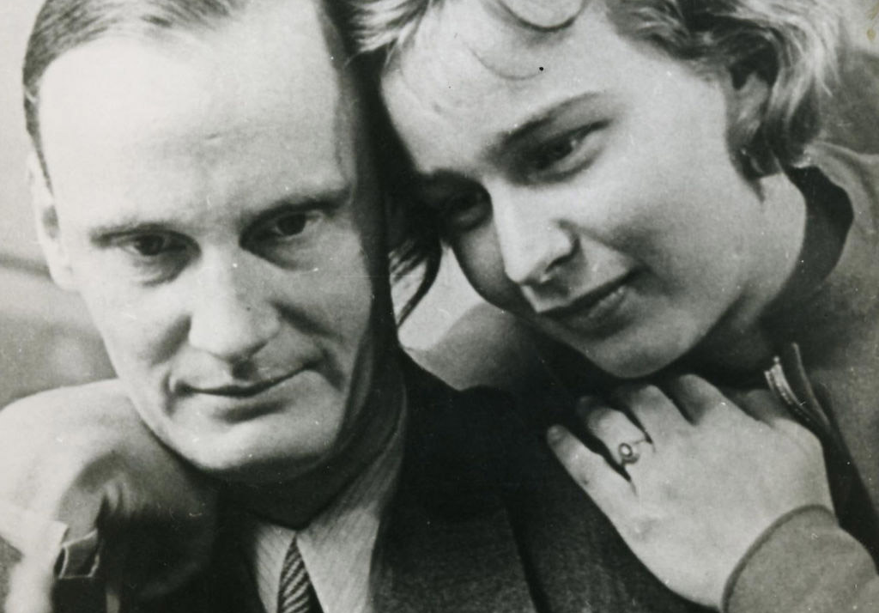
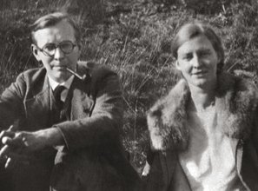
Rote Kapelle (“Red Chapel“)
pic. 1 pic. 2

Slide 2


„Wenn wir auch sterben sollen,
So wissen wir: Die Saat
Geht auf. Wenn Köpfe rollen, dann
Zwingt doch der Geist den Staat.“
Harro Schulze-Boysen; 02.09.1909
„If we, too, shall die, / we know this: The seed / grows. If heads roll, the / spirit nevertheless coerces the state.”

Slide 3
Contents
Braucht es hier nicht eine Folie mit ”basic facts”?
1. Origins of the name “The red chapel”
2. Who were the resistance fighters?
3. When was and for how long lasted their resistance?
4. How was the resistance conducted?
5. How do people remember the group today?
6. Sources

Slide 4
1. Origins of the name “Red Chapel”
The name was created by the Nazis.
It was used as a collective name for:
  People the Nazi military defence suspected to be Soviet intelligence spies
  - Networks of Western European spies in general
  - All different kinds of left groups

Slide 5
2. Who were the resistance fighters?
At the beginning, the “Rote Kapelle” was a network of a few groups all around Germany.
At least 150 women and men with different origins and ideologies were in this group.
The group build around Arvid Harnack, his wife Mildred, Harro Schulze-Boysen and his wife Libertas.
Milred and Arvid met with scientists, intellectuals, like Kurt Schumacher ( a German social democratic politician) and Günther Weissborn → Günther Weissenborn (plus info wer er war in Klammern)?
Young communists, social democrats and other Nazi enemies were also part of these discussion circles.

Slide 6
When was and for how long lasted their resistance?
In the 1930s, there were single discussing groups.
From the 1940s, the single groups connected with each other.
The resistance finally was stopped, because the Nazis wiretapped a radio message that linked the group (especially Harro Schulze-Boysen) with the leadership in Moscow.
Between August 1942 and spring 1943, the Nazis arrested at least 126 alleged members of the “Rote Kapelle”.
Many got killed by the Nazis in the concentration camp Plötzensee, north of Berlin.
Arvid Harnack and Harro Schulze-Boysen as well as his wife get murdered on the 22nd of December, 1942.
Later, the Nazis murdered more group members (also Arvid Harnacks wife) → only few group members survived

Slide 7
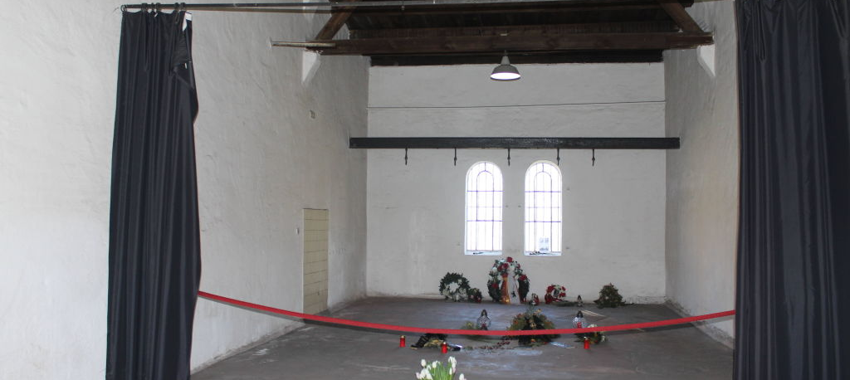
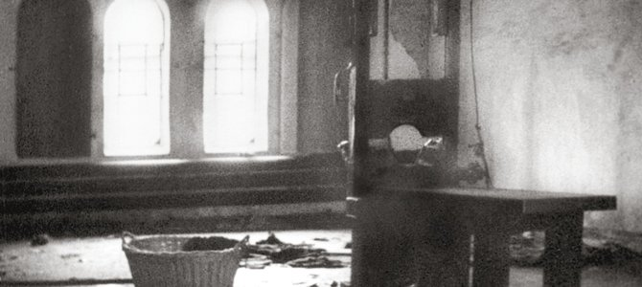
The Execution Room
Pic. 3 (above):
The Execution Room today
Pic. 4 (below): The Execution room then

Slide 8
4. How was the resistance conducted?
From 1940s, Arvid Harnack and Harro Schulze-Boysen contacted theSoviet Union’s Intelligence Service.
Harro Schulze-Boysen was first lieutenant of the news department of the Ministry of Aviation, so he could easily access information about the war.
Arvid Harnack was high ranking and important member of the Ministry of Science, so he also had access to classified information.
Harnack and Schulze-Boysen gave information to the Soviet Union about the Hitler’s plan to attacked the Soviet Union. → Stalin did not believe it.
But also in talking about the problems “openly” within the discussion groups, addressing the bad situation loud and cleas, can be seen as resistance. → ich finde hier fehlen evtl noch ein paar andere Arten des wiederstands

Slide 9
5. How do people remember the group today?
Today, people remember them for example by having named a street Schulze-Boysen Street in Berlin. In this street there is also a Memorial for the “Rote Kapelle“.
In Berlin there is also the “Mildrerd Harnack School” – the chosen name pays tribute to the resistance group. This school is in the same street as the memorial.
In the past, people in the BRD (the former western part of Germany, also known as “Federal Republic of Germany”) thought that the members of the “Rote Kapelle” were traitors and traitors to the fatherland. They were unsure if they should remember them in a good way or in a bad way.
People in the DDR (the former eastern part of Germany, also known as “German Democratic Republic”) remembered the “Rote Kapelle” better than in the west, because the DDR thought that the “Rote Kapelle” was a good anti-fascist group and followed the commands coming from Moscow.

Slide 10
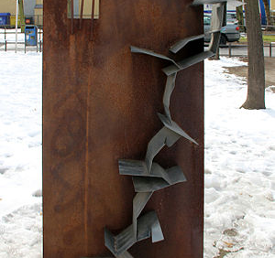
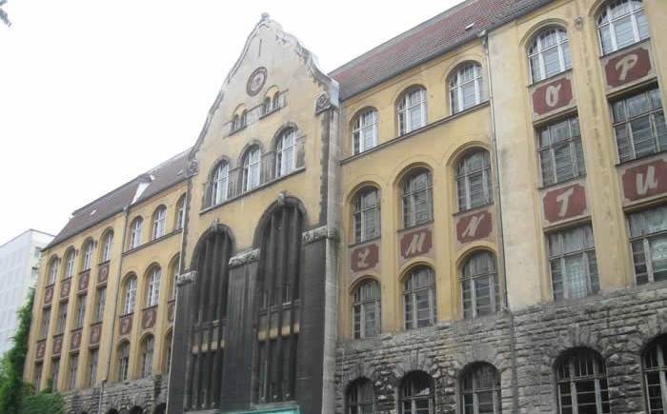
Rote Kapelle Memorial Berlin pic. 5
Mildred-Harnack-Schule
pic. 6

Slide 11
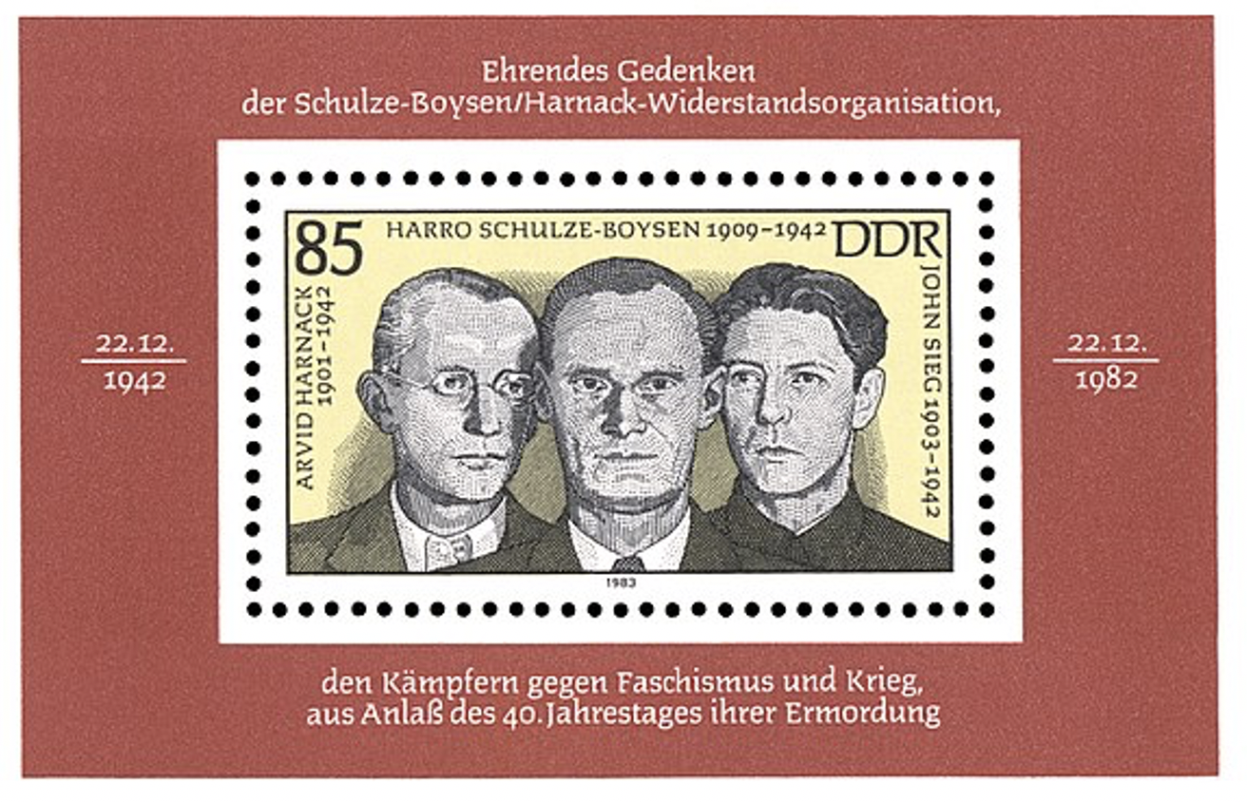
A DDR stamp remembering the 40th anniversary of the leader’s assassination
pic. 7

Slide 12
The End
presentation by Nico Goedeckemeyer, Frieder Irro and Lukas Mansberg

Slide 13
Sources
picture 1: https://www.dhm.de/fileadmin/medien/lemo/Titelbilder/ba111213.jpg (18.11.2020).
picture 2 : https://www.gedenkstaette-ploetzensee.de/hinrichtungen-in-ploetzensee/die-rote-kapelle
picture 3: https://www.google.com/search?q=rote+kapelle+erinnerung&tbm=isch&ved=2ahUKEwjG74-1k_jsAhWS34UKHf-iC40Q2-cCegQIABAA&oq=rote+kapelle+erinnerung&gs_lcp=CgNpbWcQAzoCCAA6BAgAEEM6BAgAEBhQ7rYmWMXUJmCG1iZoAHAAeACAAWuIAcYHkgEEMTAuMZgBAKABAaoBC2d3cy13aXotaW1nwAEB&sclient=img&ei=3p6qX8aIFJK_lwT_xa7oCA&bih=966&biw=1920&client=firefox-b-d#imgrc=BsG1-RkoZVDOQM
picture 4 : https://www.google.com/search?q=schulze-boysen+schule&tbm=isch&ved=2ahUKEwiRgtvjlfjsAhUDexoKHWzjBjoQ2-cCegQIABAA&oq=schulze-boysen+schule&gs_lcp=CgNpbWcQAzoHCCMQ6gIQJzoECCMQJzoECAAQQzoFCAAQsQM6BwgAELEDEEM6AggAOgQIABAeOgYIABAFEB46BggAEAgQHjoECAAQGFCxhQ1YmskNYM3NDWgCcAB4AIABaogB_A6SAQQxOS4zmAEAoAEBqgELZ3dzLXdpei1pbWewAQrAAQE&sclient=img&ei=WKGqX5H2NoP2aezGm9AD&bih=966&biw=1920&client=firefox-b-d#imgrc=rUaXwKlEHwaNxM
picture 5 : https://www.google.com/search?q=kz+pl%C3%B6tzensee+hinrichtungsraum&client=firefox-b-d&sxsrf=ALeKk01pu51t9VCSf0f0auHrOotlQIoCHg:1605016641822&source=lnms&tbm=isch&sa=X&ved=2ahUKEwjz9az2kPjsAhUGmhQKHZ0mDqEQ_AUoAnoECAoQBA&biw=1920&bih=966#imgrc=KZP26ZG9oqbtYM
picture 6 : https://www.gedenkstaette-ploetzensee.de/mord-durch-fallbeil-und-strang
picture 7: https://www.google.com/search?q=rote+kapelle&client=firefox-b-d&sxsrf=ALeKk01MVoRL3Orq_dAS-dt-rrl25g7_-g:1605534808948&source=lnms&tbm=isch&sa=X&ved=2ahUKEwihrdifm4ftAhXD6aQKHXGtDGgQ_AUoAXoECBAQAw&biw=1920&bih=966#imgrc=ELnuQ7fFPs528M
The information on “Rote Kapelle” presented in this presentation is taken from: https://www.bpb.de/politik/hintergrund-aktuell/262160/rote-kapelle (16.11.2020). The website is in German, so the information got translated to our best knowledge.

